Slide 1
Moffat Bay Lodge Project
Alpha Team
Module 11
May 7, 2025

Slide 2
Meet the Team
Our Team consists of the following members:
Andres Melendez
Jeffrey Reid
Jordany Gonzalez
Edgar Arroyo
Matthew Trinh
All members participated in planning, code development on front and backend, and testing.

Slide 3
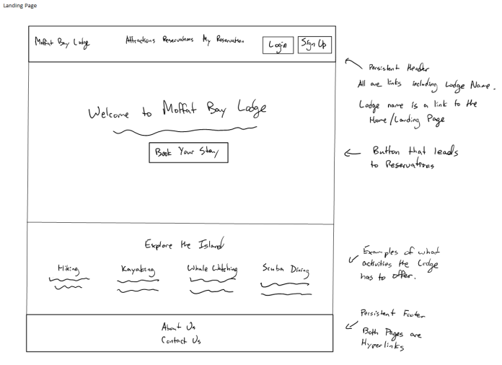
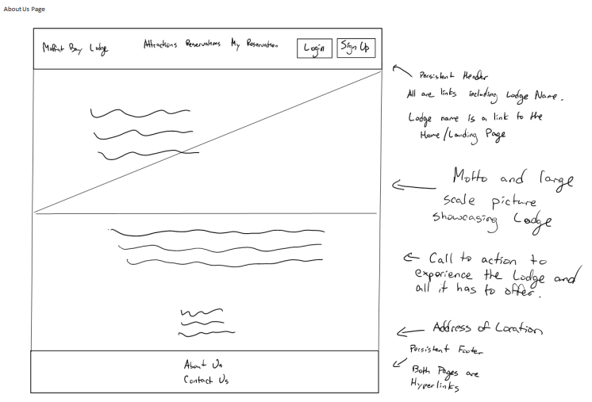
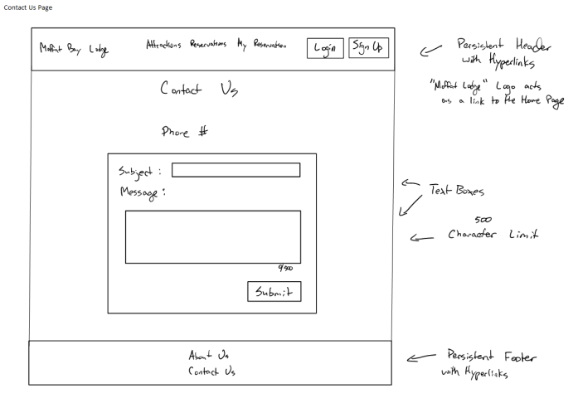
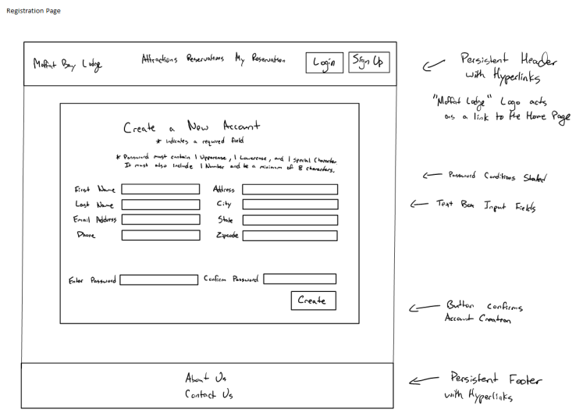
Wireframes
These are the original designs for our site.

Slide 4
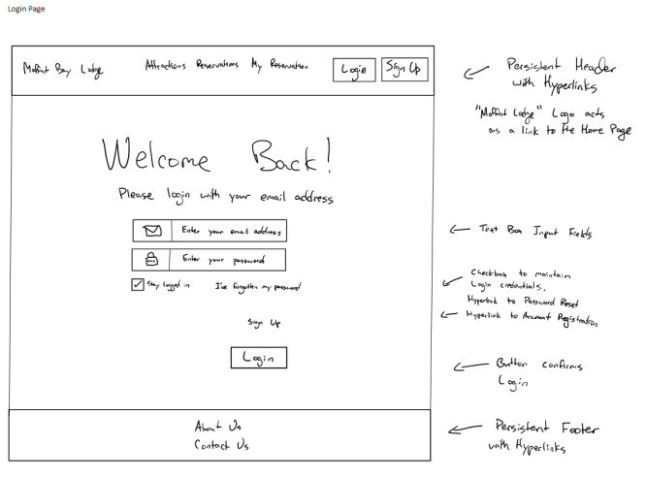
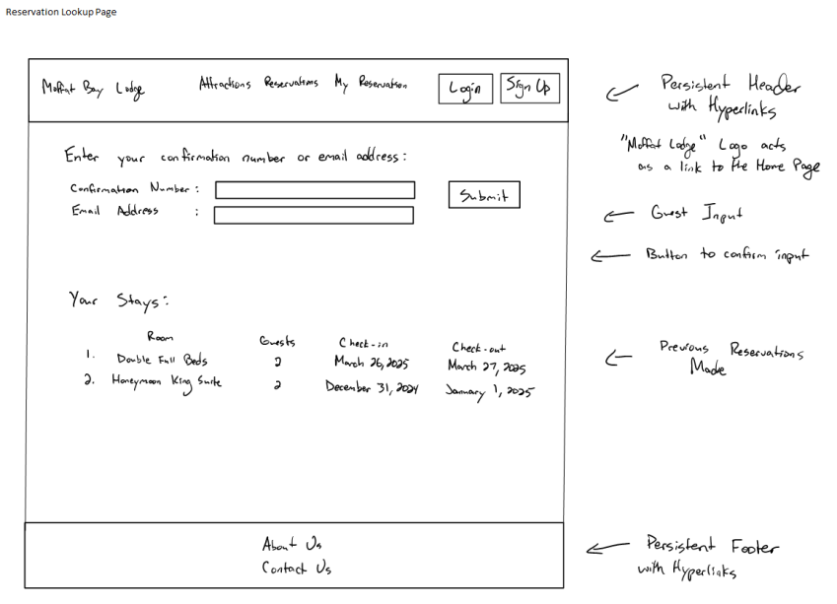
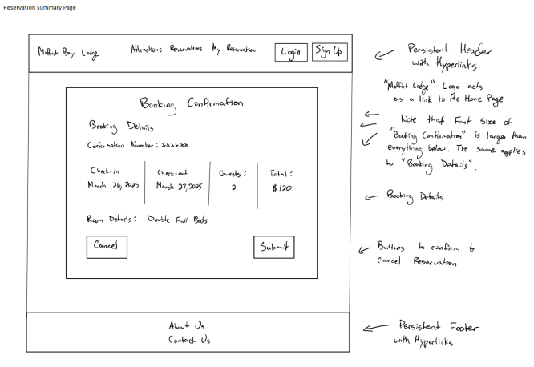
Wireframes Cont’d
These are the original designs for our site.

Slide 5
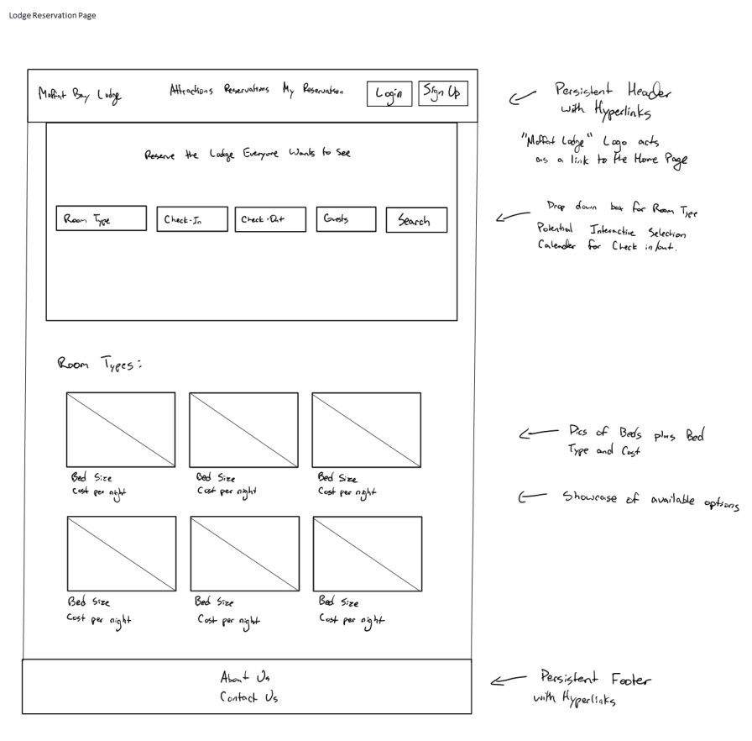
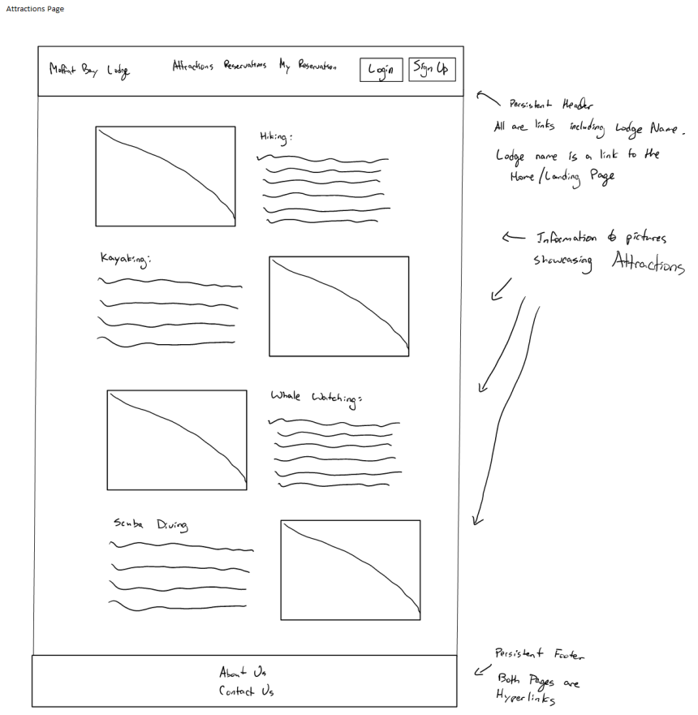
Wireframes Cont’d
These are the original designs for our site.

Slide 6
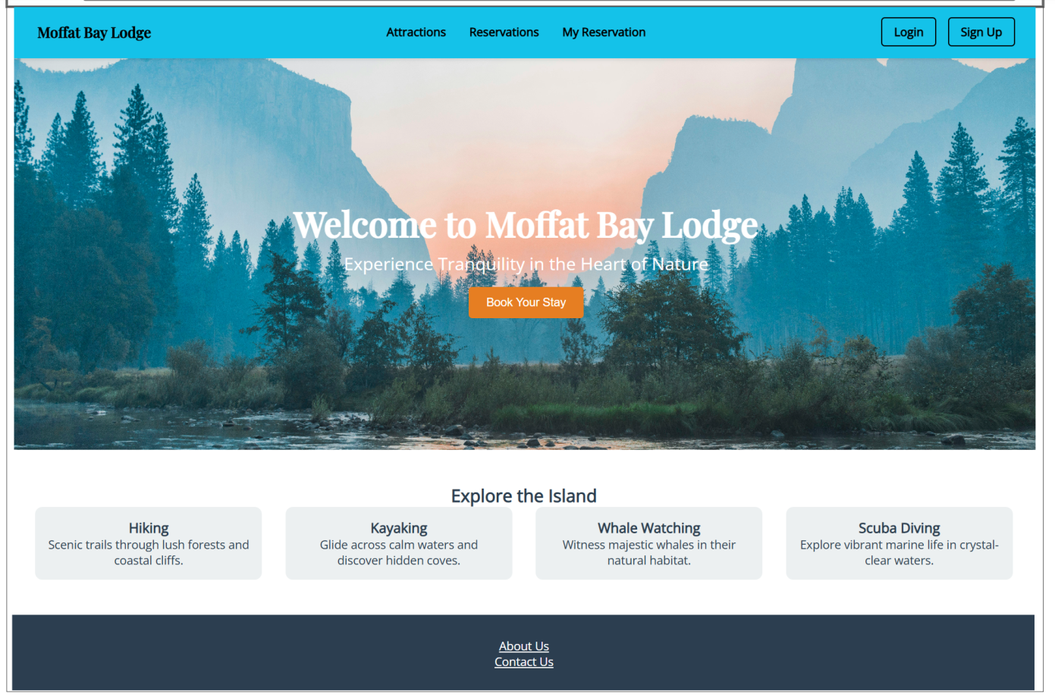
Prototype
Below is our Landing Page where the experience all begins!

Slide 7
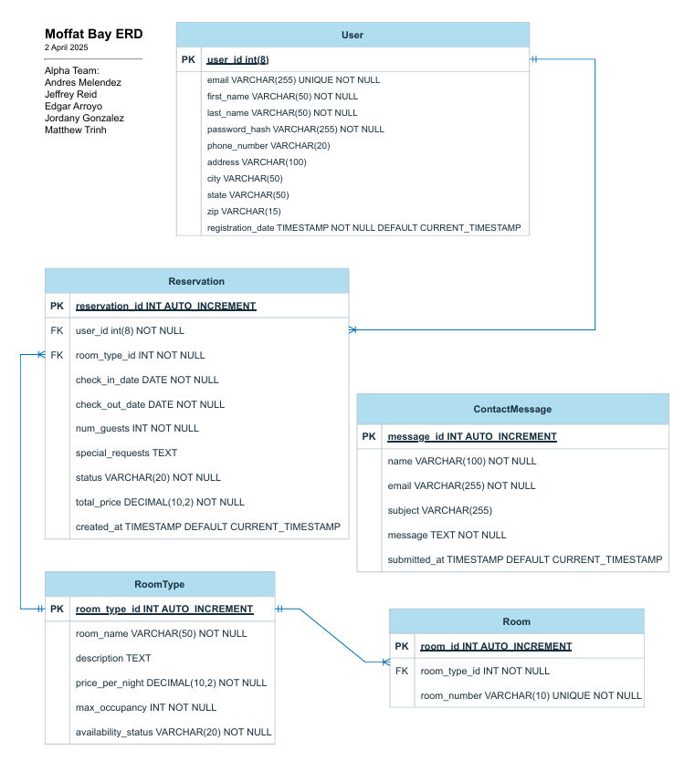
ERD Original
Our ERD represents the database that we used for the website. We had to modify it a few times throughout the project.
This is the original design we had.

Slide 8
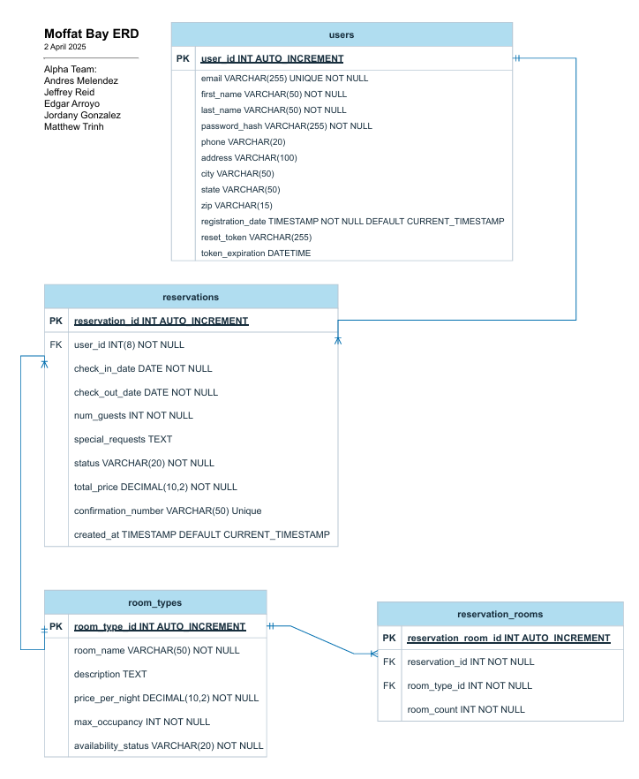
ERD Final
This is the final result of these changes.
Notice the removal of the ContactMessage Table, addition of token fields on the Users Table, and the big changes on the Reservation Rooms Table.
These helped facilitate very important changes to correct functionality for Reservations.
The tokens in particular enabled Password Reset functionality.

Slide 9
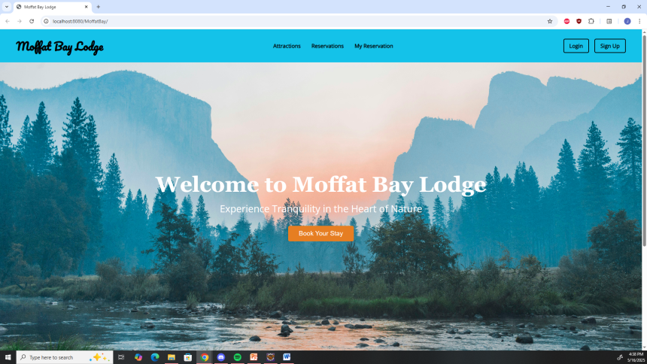
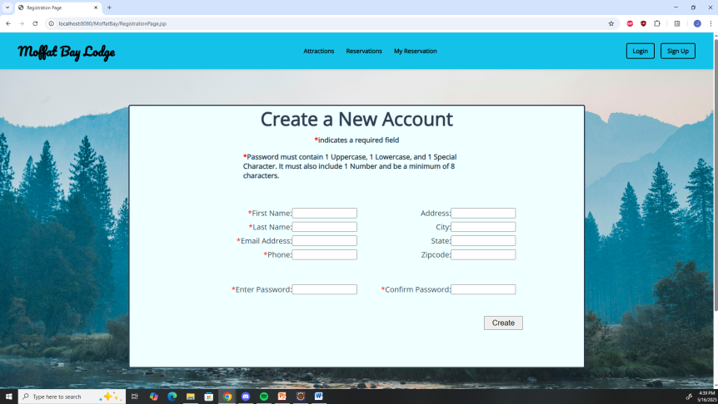
Functional Tests 1 of 6
Landing Page Verification Test:
Early in the process of the project we developed our landing page.
One of our keys tests involved successful navigation from the hub to other pages.
This involved traveling to the constructed “Login” and “Sign Up” pages to determine they interacted with each other as expected.
Though they were placeholders at the time, we also tested navigation to the “Reservations”, “Attractions”, and “My Reservations” pages.
The results were as we expected:
Navigation to the pages created at the time succeeded.
Navigation to the unconstructed pages failed as they didn’t exist yet.

Slide 10
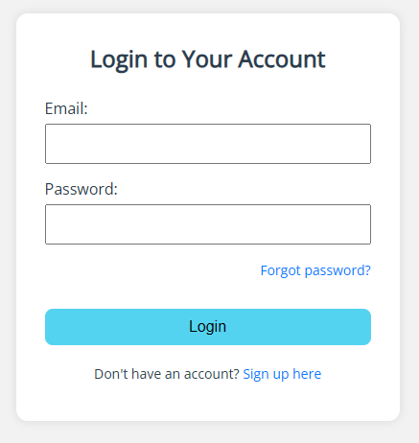
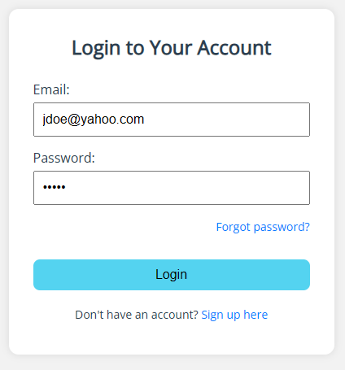
Functional Tests 2 of 6
Login Page Successful Login Test:
For the Login page we had a test that checked to see if a user could successfully login to the website.
This test involved navigating to the Login page, inputting valid credentials, and logging in.
We used login information from our initially constructed database for these tests.
As bonus side tests, login tests were also completed with newly registered accounts.
All accounts were successful with logging into the website!

Slide 11
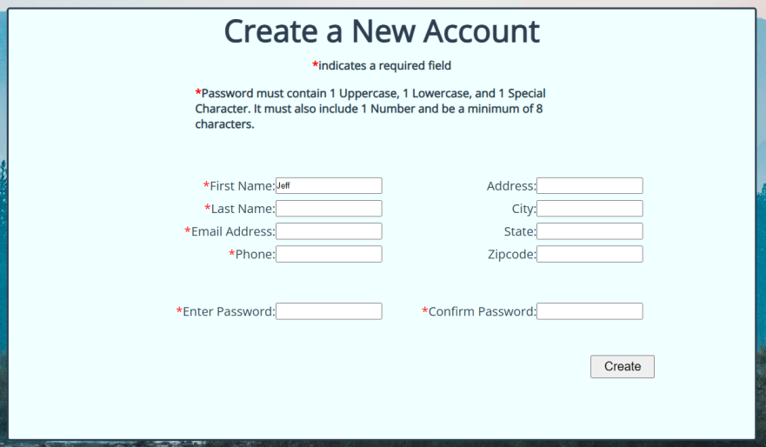
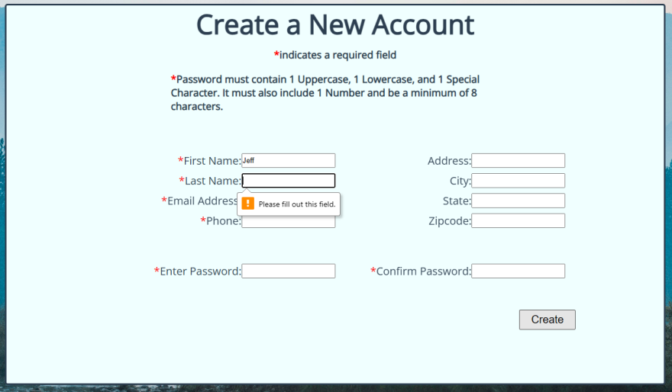
Functional Tests 3 of 6
Registration with Missing Information Test:
A very important test we devised involving checking user input and validating that all required information was given.
Valid information that the user must submit included First and Last Name, Email, Phone Number, and Password.
Of course a password validation check (Confirm Password) was included.
The test involved omitting some, or all, of the required fields with an appropriate error message on display when registration was attempted.
Each of the required fields had an appropriate message such as “Email is required” and “Password must match”.
This test passed upon testing as expected.

Slide 12
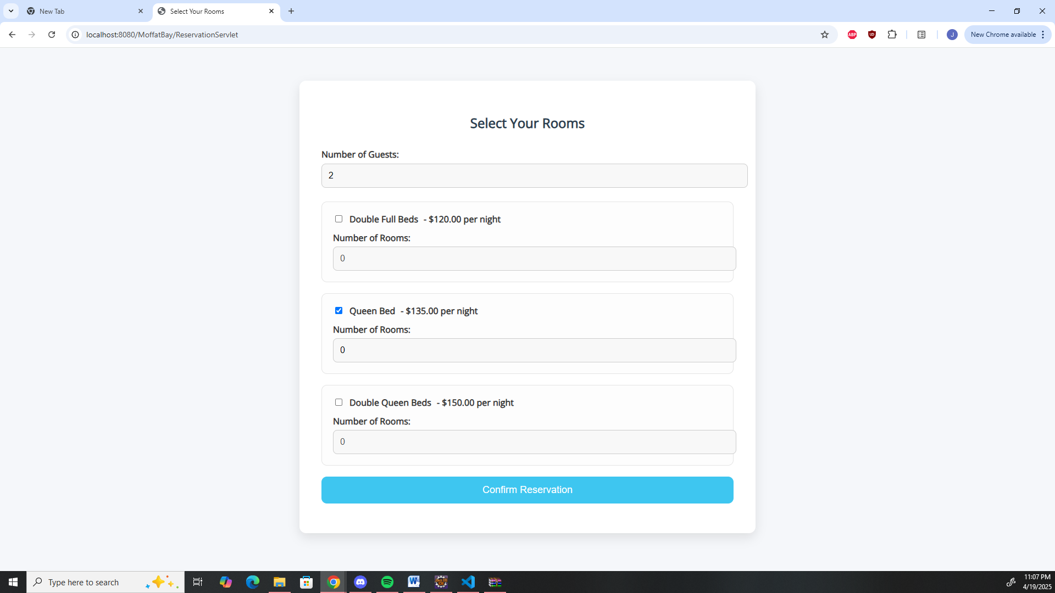
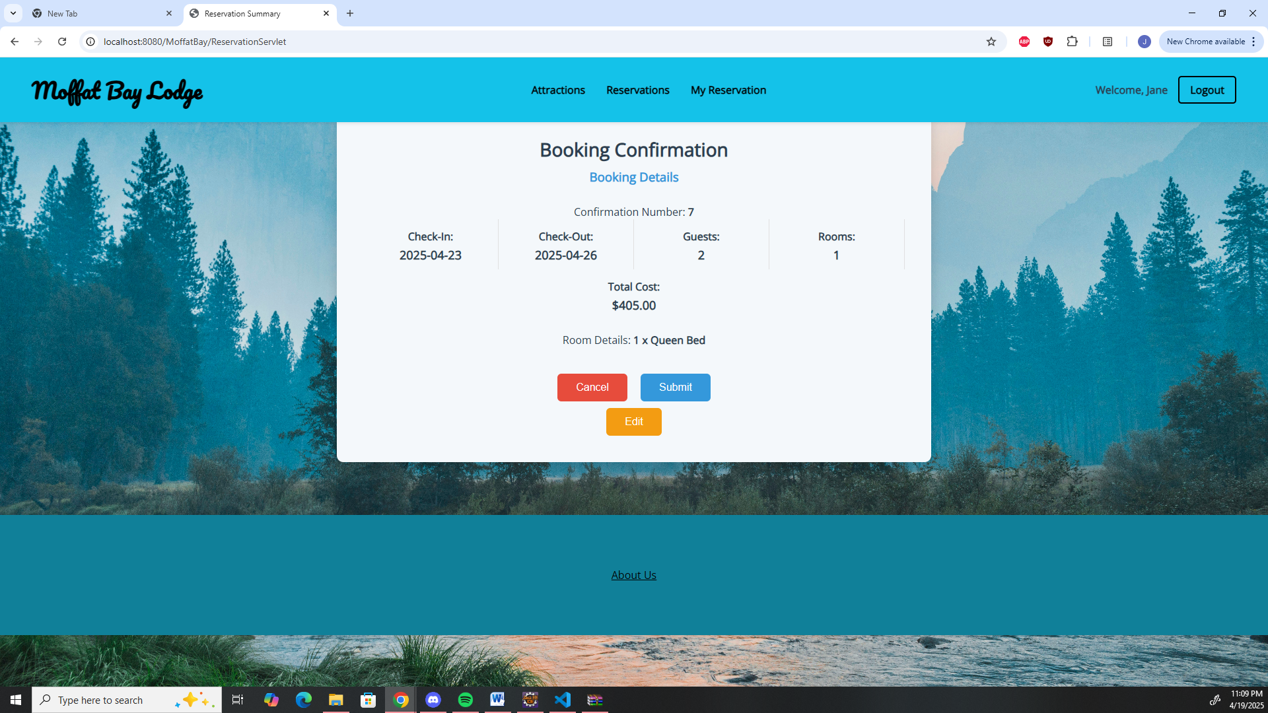
Functional Tests 4 of 6
Verification of Booking Test:
At this point in time our Reservation Page was up and running and needed to be tested.
We set up a test to fill in a reservation and confirm the details were correct.
This test resulted in a pass for our initial user selection and a successful booking but a fail on the precise displayed information.
The important part of this test was that it showed us that we needed to tweak our Reservation Servlet to properly show the correct values to the user when the Reservation Confirmation page we created was on display.

Slide 13
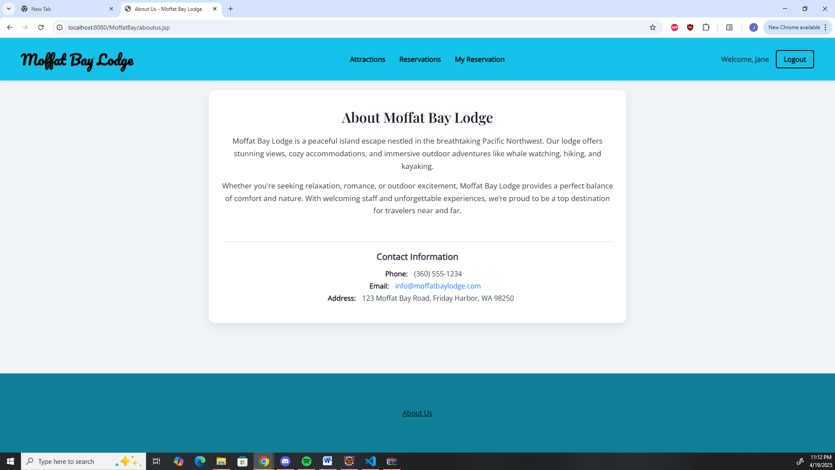
Functional Tests 5 of 6
About Us Page Information Verification Test:
Our client requested we effectively merge our About Us and Contact Us pages.
This meant that the Moffat Bay contact information and call-to-action were on the same page.
This test involved verifying that all required information that the client required was present and the layout was correct.
This simple test passed with all information clearly displayed with no errors for the links as well as all text present & legible.

Slide 14
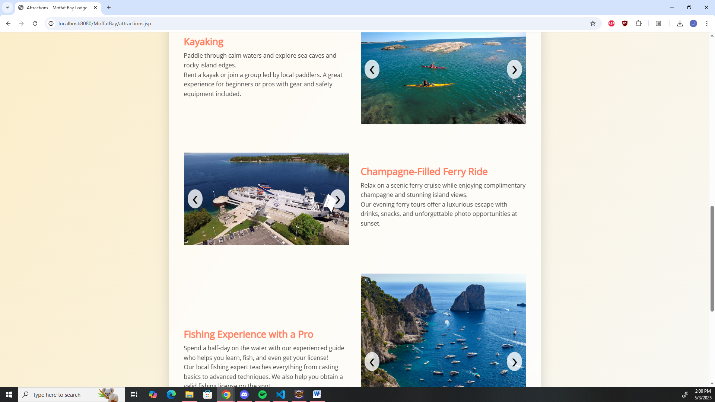
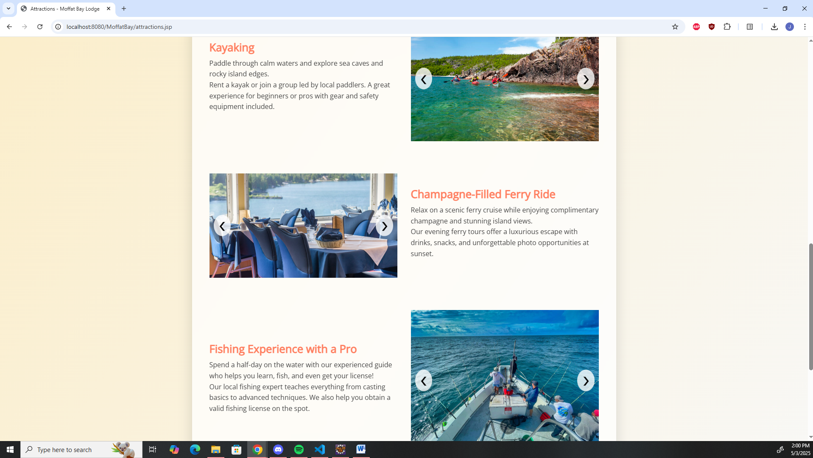
Functional Tests 6 of 6
Attractions Page Carousel Image Test:
To maximize the attractions display without bloating the page, we employed an image carousel on this page.
The test involved testing this functionality to make sure it rotated between three images each as the user pressed the buttons.
A bonus test involved ensuring the page was responsive to different browser sizes.
These tests were successful!
As the user pressed the arrows, the images changed as expected.
Shrinking the window adjusted the alignment of the elements to a vertical setting as expected.
The page functioned across different browsers.

Slide 15
Lessons Learned
Pre-planning is vital to groups that have different availability schedules.
Our group had some people available at the beginning of the week and others at the end.
The importance of comments.
Comments are important for identifying the purpose of segments of code.
Without us implementing these later on debugging would have been much more difficult.

Slide 16
Lessons Learned Cont’d
Proper division of work is necessary for groups to thrive.
This showcases each individuals talents and helps construct a product that benefits from all.
Also avoids the feeling of missing out or overworking for other group members.
External obstacles do come up every now and then. Adaptation is key to navigate these.
Sometimes personal matters come up like moving to a new location or a surprise trip to another state.
The key is empathy and adjustments by the involved members and the group as a whole for overall success.

